Slide 1
Introduction to Parallel Computing

Slide 2
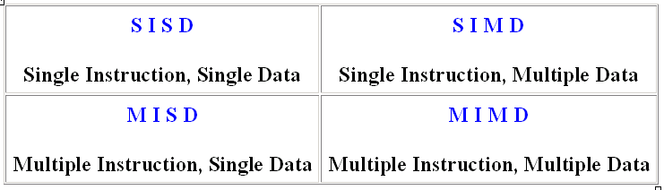
Flynn Taxanomy
The matrix below defines the 4 possible classifications according to Flynn

Slide 3
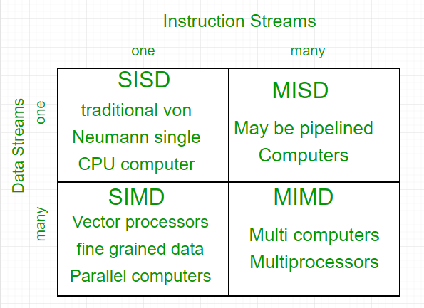
Flynn Taxanomy

Slide 4
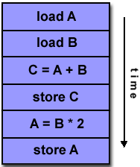
Single Instruction, Single Data (SISD)
A serial (non-parallel) computer
Single instruction: only one instruction stream is being acted on by the CPU during any one clock cycle
Single data: only one data stream is being used as input during any one clock cycle
Deterministic execution
This is the oldest and until recently, the most prevalent form of computer
Examples: most PCs, single CPU workstations and mainframes

Slide 5
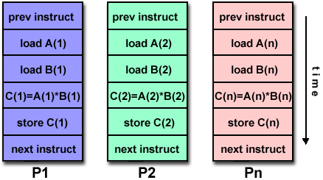
Single Instruction, Multiple Data (SIMD)
A type of parallel computer
Single instruction: All processing units execute the same instruction at any given clock cycle
Multiple data: Each processing unit can operate on a different data element
This type of machine typically has an instruction dispatcher, a very high-bandwidth internal network, and a very large array of very small-capacity instruction units.
Best suited for specialized problems characterized by a high degree of regularity,such as image processing.
Synchronous (lockstep) and deterministic execution
Two varieties: Processor Arrays and Vector Pipelines
Examples:
Processor Arrays: Connection Machine CM-2, Maspar MP-1, MP-2
Vector Pipelines: IBM 9000, Cray C90, Fujitsu VP, NEC SX-2, Hitachi S820

Slide 6
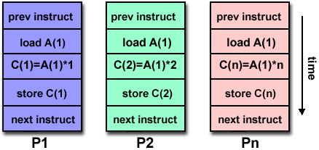
Multiple Instruction, Single Data (MISD)
A single data stream is fed into multiple processing units.
Each processing unit operates on the data independently via independent instruction streams.
Few actual examples of this class of parallel computer have ever existed. One is the experimental Carnegie-Mellon C.mmp computer (1971).
Some conceivable uses might be:
multiple frequency filters operating on a single signal stream
multiple cryptography algorithms attempting to crack a single coded message.

Slide 7
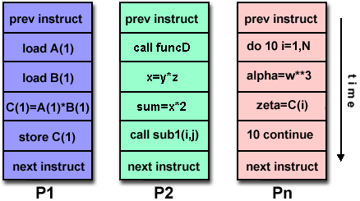
Multiple Instruction, Multiple Data (MIMD)
Currently, the most common type of parallel computer. Most modern computers fall into this category.
Multiple Instruction: every processor may be executing a different instruction stream
Multiple Data: every processor may be working with a different data stream
Execution can be synchronous or asynchronous, deterministic or non-deterministic
Examples: most current supercomputers, networked parallel computer "grids" and multi-processor SMP computers - including some types of PCs.

Slide 8
Some General Parallel Terminology
Task
A logically discrete section of computational work. A task is typically a program or program-like set of instructions that is executed by a processor.
Parallel Task
A task that can be executed by multiple processors safely (yields correct results)
Serial Execution
Execution of a program sequentially, one statement at a time. In the simplest sense, this is what happens on a one processor machine. However, virtually all parallel tasks will have sections of a parallel program that must be executed serially.

Slide 9
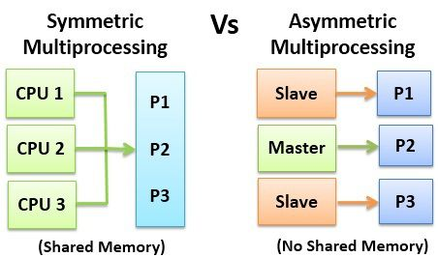
Symmetric vs. Asymmetric Multiprocessing Architecture [1/2]

Slide 10
Some General Parallel Terminology
Parallel Execution
Execution of a program by more than one task, with each task being able to execute the same or different statement at the same moment in time.
Shared Memory
From a strictly hardware point of view, describes a computer architecture where all processors have direct (usually bus based) access to common physical memory. In a programming sense, it describes a model where parallel tasks all have the same "picture" of memory and can directly address and access the same logical memory locations regardless of where the physical memory actually exists.
Distributed Memory
In hardware, refers to network based memory access for physical memory that is not common. As a programming model, tasks can only logically "see" local machine memory and must use communications to access memory on other machines where other tasks are executing.

Slide 11
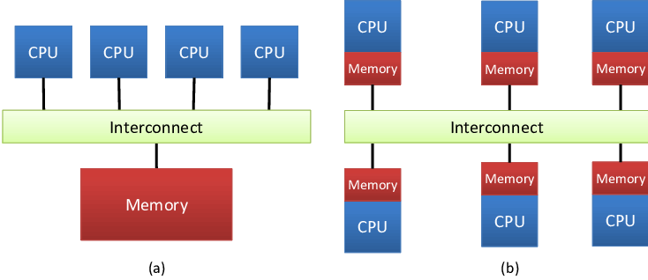
Shared Memory vs. Distributed Memory
Fig a) Shared Memory Fig b) Distributed Memory

Slide 12
Some General Parallel Terminology
Communications
Parallel tasks typically need to exchange data. There are several ways this can be accomplished, such as through a shared memory bus or over a network, however the actual event of data exchange is commonly referred to as communications regardless of the method employed.
Synchronization
The coordination of parallel tasks in real time, very often associated with communications. Often implemented by establishing a synchronization point within an application where a task may not proceed further until another task(s) reaches the same or logically equivalent point.
Synchronization usually involves waiting by at least one task, and can therefore cause a parallel application's wall clock execution time to increase.

Slide 13
Some General Parallel Terminology
Granularity
In parallel computing, granularity is a qualitative measure of the ratio of computation to communication.
Coarse: relatively large amounts of computational work are done between communication events
Fine: relatively small amounts of computational work are done between communication events
Observed Speedup
Observed speedup of a code which has been parallelized, defined as:
wall-clock time of serial execution
wall-clock time of parallel execution
One of the simplest and most widely used indicators for a parallel program's performance.

Slide 14
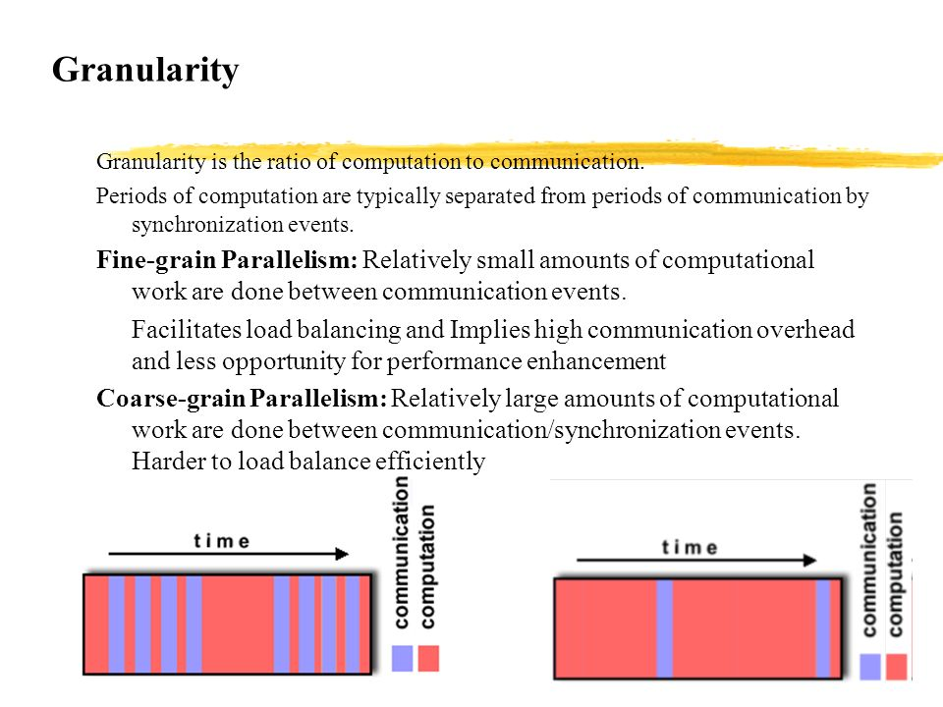

Slide 15
Some General Parallel Terminology
Parallel Overhead
The amount of time required to coordinate parallel tasks, as opposed to doing useful work. Parallel overhead can include factors such as:
Task start-up time
Synchronizations
Data communications
Software overhead imposed by parallel compilers, libraries, tools, operating system, etc.
Task termination time
Massively Parallel
Refers to the hardware that comprises a given parallel system - having many processors. The meaning of many keeps increasing, but currently BG/L pushes this number to 6 digits.

Slide 16
Some General Parallel Terminology
Scalability
Refers to a parallel system's (hardware and/or software) ability to demonstrate a proportionate increase in parallel speedup with the addition of more processors. Factors that contribute to scalability include:
Hardware - particularly memory-cpu bandwidths and network communications
Application algorithm
Parallel overhead related
Characteristics of your specific application and coding

Slide 17
Parallel Computer Memory Architectures

Slide 18
Memory architectures
Shared Memory
Distributed Memory
Hybrid Distributed-Shared Memory

Slide 19
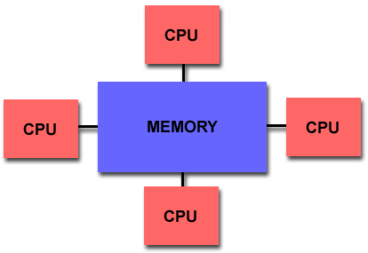
Shared Memory
Shared memory parallel computers vary widely, but generally have in common the ability for all processors to access all memory as global address space.
Multiple processors can operate independently but share the same memory resources.
Changes in a memory location effected by one processor are visible to all other processors.
Shared memory machines can be divided into two main classes based upon memory access times: UMA and NUMA.

Slide 20
Shared Memory : UMA vs. NUMA
Uniform Memory Access (UMA):
Most commonly represented today by Symmetric Multiprocessor (SMP) machines
Identical processors
Equal access and access times to memory
Sometimes called CC-UMA - Cache Coherent UMA. Cache coherent means if one processor updates a location in shared memory, all the other processors know about the update. Cache coherency is accomplished at the hardware level.
Non-Uniform Memory Access (NUMA):
Often made by physically linking two or more SMPs
One SMP can directly access memory of another SMP
Not all processors have equal access time to all memories
Memory access across link is slower
If cache coherency is maintained, then may also be called CC-NUMA - Cache Coherent NUMA

Slide 21
Shared Memory: Pro and Con
Advantages
Global address space provides a user-friendly programming perspective to memory
Data sharing between tasks is both fast and uniform due to the proximity of memory to CPUs
Disadvantages:
Primary disadvantage is the lack of scalability between memory and CPUs. Adding more CPUs can geometrically increases traffic on the shared memory-CPU path, and for cache coherent systems, geometrically increase traffic associated with cache/memory management.
Programmer responsibility for synchronization constructs that insure "correct" access of global memory.
Expense: it becomes increasingly difficult and expensive to design and produce shared memory machines with ever increasing numbers of processors.

Slide 22
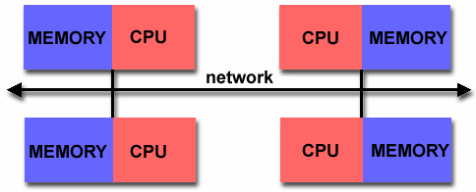
Distributed Memory
Like shared memory systems, distributed memory systems vary widely but share a common characteristic. Distributed memory systems require a communication network to connect inter-processor memory.
Processors have their own local memory. Memory addresses in one processor do not map to another processor, so there is no concept of global address space across all processors.
Because each processor has its own local memory, it operates independently. Changes it makes to its local memory have no effect on the memory of other processors. Hence, the concept of cache coherency does not apply.
When a processor needs access to data in another processor, it is usually the task of the programmer to explicitly define how and when data is communicated. Synchronization between tasks is likewise the programmer's responsibility.
The network "fabric" used for data transfer varies widely, though it can can be as simple as Ethernet.

Slide 23
Distributed Memory: Pro and Con
Advantages
Memory is scalable with number of processors. Increase the number of processors and the size of memory increases proportionately.
Each processor can rapidly access its own memory without interference and without the overhead incurred with trying to maintain cache coherency.
Cost effectiveness: can use commodity, off-the-shelf processors and networking.
Disadvantages
The programmer is responsible for many of the details associated with data communication between processors.
It may be difficult to map existing data structures, based on global memory, to this memory organization.
Non-uniform memory access (NUMA) times

Slide 24
Hybrid Distributed-Shared Memory
Summarizing a few of the key characteristics of shared and distributed memory machines
Comparison of Shared and Distributed Memory Architectures
Architecture | CC-UMA | CC-NUMA | Distributed
Examples | SMPs Sun Vexx DEC/Compaq SGI Challenge IBM POWER3 | Bull NovaScale SGI Origin Sequent HP Exemplar DEC/Compaq IBM POWER4 (MCM) | Cray T3E Maspar IBM SP2 IBM BlueGene
Communications | MPI Threads OpenMP shmem | MPI Threads OpenMP shmem | MPI
Scalability | to 10s of processors | to 100s of processors | to 1000s of processors
Draw Backs | Memory-CPU bandwidth | Memory-CPU bandwidth Non-uniform access times | System administration Programming is hard to develop and maintain
Software Availability | many 1000s ISVs | many 1000s ISVs | 100s ISVs

Slide 25
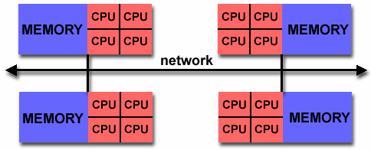
Hybrid Distributed-Shared Memory
The largest and fastest computers in the world today employ both shared and distributed memory architectures.
The shared memory component is usually a cache coherent SMP machine. Processors on a given SMP can address that machine's memory as global.
The distributed memory component is the networking of multiple SMPs. SMPs know only about their own memory - not the memory on another SMP. Therefore, network communications are required to move data from one SMP to another.
Current trends seem to indicate that this type of memory architecture will continue to prevail and increase at the high end of computing for the foreseeable future.
Advantages and Disadvantages: whatever is common to both shared and distributed memory architectures.

Slide 26
Parallel Programming Models

Slide 27
Overview
There are several parallel programming models in common use:
Shared Memory
Threads
Message Passing
Data Parallel
Hybrid
Parallel programming models exist as an abstraction above hardware and memory architectures.

Slide 28
Overview
Although it might not seem apparent, these models are NOT specific to a particular type of machine or memory architecture. In fact, any of these models can (theoretically) be implemented on any underlying hardware.
Shared memory model on a distributed memory machine: Kendall Square Research (KSR) ALLCACHE approach.
Machine memory was physically distributed, but appeared to the user as a single shared memory (global address space). Generically, this approach is referred to as "virtual shared memory".
Note: although KSR is no longer in business, there is no reason to suggest that a similar implementation will not be made available by another vendor in the future.
Message passing model on a shared memory machine: MPI on SGI Origin.
The SGI Origin employed the CC-NUMA type of shared memory architecture, where every task has direct access to global memory. However, the ability to send and receive messages with MPI, as is commonly done over a network of distributed memory machines, is not only implemented but is very commonly used.

Slide 29
Overview
Which model to use is often a combination of what is available and personal choice. There is no "best" model, although there certainly are better implementations of some models over others.
The following sections describe each of the models mentioned above, and also discuss some of their actual implementations.

Slide 30
Assignment
Write a program for any one sorting algorithm in Serial, Pthreads (Parallel Programming), and OpenMP (Parllel Programming with Shared Memory) using C language. Compare the execution time of all three programs on 10000,20000, 50000,100000, and 200000 elements.
Illustrate your comparison through graph and write your own conclusion.
Algorithms: Quick Sort, Merge Sort, Selection Sort, Insertion Sort.
Note: Every student is supposed to Submit individual zip file which consists of code, Graph , and conclusion document.
Due Date: 18th Sept,20

Slide 31
Shared Memory Model
In the shared-memory programming model, tasks share a common address space, which they read and write asynchronously.
Various mechanisms such as locks / semaphores may be used to control access to the shared memory.
An advantage of this model from the programmer's point of view is that the notion of data "ownership" is lacking, so there is no need to specify explicitly the communication of data between tasks. Program development can often be simplified.
An important disadvantage in terms of performance is that it becomes more difficult to understand and manage data locality.

Slide 32
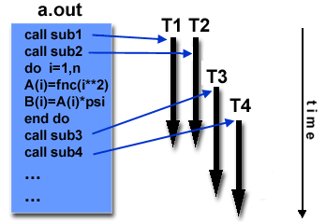
Threads Model
In the threads model of parallel programming, a single process can have multiple, concurrent execution paths.
Perhaps the most simple analogy that can be used to describe threads is the concept of a single program that includes a number of subroutines:
The main program a.out is scheduled to run by the native operating system. a.out loads and acquires all of the necessary system and user resources to run.
a.out performs some serial work, and then creates a number of tasks (threads) that can be scheduled and run by the operating system concurrently.
Each thread has local data, but also, shares the entire resources of a.out. This saves the overhead associated with replicating a program's resources for each thread. Each thread also benefits from a global memory view because it shares the memory space of a.out.
A thread's work may best be described as a subroutine within the main program. Any thread can execute any subroutine at the same time as other threads.
Threads communicate with each other through global memory (updating address locations). This requires synchronization constructs to insure that more than one thread is not updating the same global address at any time.
Threads can come and go, but a.out remains present to provide the necessary shared resources until the application has completed.
Threads are commonly associated with shared memory architectures and operating systems.

Slide 33
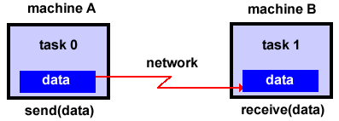
Threads Model Implementations
From a programming perspective, threads implementations commonly comprise:
A library of subroutines that are called from within parallel source code
A set of compiler directives imbedded in either serial or parallel source code
In both cases, the programmer is responsible for determining all parallelism.
Threaded implementations are not new in computing. Historically, hardware vendors have implemented their own proprietary versions of threads. These implementations differed substantially from each other making it difficult for programmers to develop portable threaded applications.
Unrelated standardization efforts have resulted in two very different implementations of threads: POSIX Threads and OpenMP.
POSIX Threads
Library based; requires parallel coding
Specified by the IEEE POSIX 1003.1c standard (1995).
C Language only
Commonly referred to as Pthreads.
Most hardware vendors now offer Pthreads in addition to their proprietary threads implementations.
Very explicit parallelism; requires significant programmer attention to detail.

Slide 34
Threads Model: OpenMP
OpenMP
Compiler directive based; can use serial code
Jointly defined and endorsed by a group of major computer hardware and software vendors. The OpenMP Fortran API was released October 28, 1997. The C/C++ API was released in late 1998.
Portable / multi-platform, including Unix and Windows NT platforms
Available in C/C++ and Fortran implementations
Can be very easy and simple to use - provides for "incremental parallelism"
Microsoft has its own implementation for threads, which is not related to the UNIX POSIX standard or OpenMP.

Slide 35
Message Passing Model
The message passing model demonstrates the following characteristics:
A set of tasks that use their own local memory during computation. Multiple tasks can reside on the same physical machine as well across an arbitrary number of machines.
Tasks exchange data through communications by sending and receiving messages.
Data transfer usually requires cooperative operations to be performed by each process. For example, a send operation must have a matching receive operation.

Slide 36
Message Passing Model Implementations: MPI
From a programming perspective, message passing implementations commonly comprise a library of subroutines that are imbedded in source code. The programmer is responsible for determining all parallelism.
Historically, a variety of message passing libraries have been available since the 1980s. These implementations differed substantially from each other making it difficult for programmers to develop portable applications.
In 1992, the MPI Forum was formed with the primary goal of establishing a standard interface for message passing implementations.
Part 1 of the Message Passing Interface (MPI) was released in 1994. Part 2 (MPI-2) was released in 1996. Both MPI specifications are available on the web at www.mcs.anl.gov/Projects/mpi/standard.html.

Slide 37
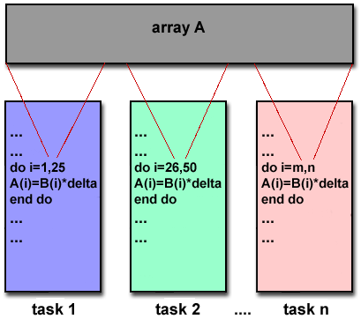
Message Passing Model Implementations: MPI
MPI is now the "de facto" industry standard for message passing, replacing virtually all other message passing implementations used for production work. Most, if not all of the popular parallel computing platforms offer at least one implementation of MPI. A few offer a full implementation of MPI-2.
For shared memory architectures, MPI implementations usually don't use a network for task communications. Instead, they use shared memory (memory copies) for performance reasons.

Slide 38
Data Parallel Model
The data parallel model demonstrates the following characteristics:
Most of the parallel work focuses on performing operations on a data set. The data set is typically organized into a common structure, such as an array or cube.
A set of tasks work collectively on the same data structure, however, each task works on a different partition of the same data structure.
Tasks perform the same operation on their partition of work, for example, "add 4 to every array element".
On shared memory architectures, all tasks may have access to the data structure through global memory. On distributed memory architectures the data structure is split up and resides as "chunks" in the local memory of each task.

Slide 39
Data Parallel Model Implementations
Programming with the data parallel model is usually accomplished by writing a program with data parallel constructs. The constructs can be calls to a data parallel subroutine library or, compiler directives recognized by a data parallel compiler.
Fortran 90 and 95 (F90, F95): ISO/ANSI standard extensions to Fortran 77.
Contains everything that is in Fortran 77
New source code format; additions to character set
Additions to program structure and commands
Variable additions - methods and arguments
Pointers and dynamic memory allocation added
Array processing (arrays treated as objects) added
Recursive and new intrinsic functions added
Many other new features
Implementations are available for most common parallel platforms.

Slide 40
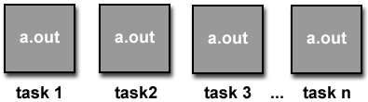
Data Parallel Model Implementations
High Performance Fortran (HPF): Extensions to Fortran 90 to support data parallel programming.
Contains everything in Fortran 90
Directives to tell compiler how to distribute data added
Assertions that can improve optimization of generated code added
Data parallel constructs added (now part of Fortran 95)
Implementations are available for most common parallel platforms.
Compiler Directives: Allow the programmer to specify the distribution and alignment of data. Fortran implementations are available for most common parallel platforms.
Distributed memory implementations of this model usually have the compiler convert the program into standard code with calls to a message passing library (MPI usually) to distribute the data to all the processes. All message passing is done invisibly to the programmer.

Slide 41
Other Models
Other parallel programming models besides those previously mentioned certainly exist, and will continue to evolve along with the ever changing world of computer hardware and software.
Only three of the more common ones are mentioned here.
Hybrid
Single Program Multiple Data
Multiple Program Multiple Data

Slide 42
Hybrid
In this model, any two or more parallel programming models are combined.
Currently, a common example of a hybrid model is the combination of the message passing model (MPI) with either the threads model (POSIX threads) or the shared memory model (OpenMP). This hybrid model lends itself well to the increasingly common hardware environment of networked SMP machines.
Another common example of a hybrid model is combining data parallel with message passing. As mentioned in the data parallel model section previously, data parallel implementations (F90, HPF) on distributed memory architectures actually use message passing to transmit data between tasks, transparently to the programmer.

Slide 43
Single Program Multiple Data (SPMD)
Single Program Multiple Data (SPMD):
SPMD is actually a "high level" programming model that can be built upon any combination of the previously mentioned parallel programming models.
A single program is executed by all tasks simultaneously.
At any moment in time, tasks can be executing the same or different instructions within the same program.
SPMD programs usually have the necessary logic programmed into them to allow different tasks to branch or conditionally execute only those parts of the program they are designed to execute. That is, tasks do not necessarily have to execute the entire program - perhaps only a portion of it.
All tasks may use different data

Slide 44
Multiple Program Multiple Data (MPMD)
Multiple Program Multiple Data (MPMD):
Like SPMD, MPMD is actually a "high level" programming model that can be built upon any combination of the previously mentioned parallel programming models.
MPMD applications typically have multiple executable object files (programs). While the application is being run in parallel, each task can be executing the same or different program as other tasks.
All tasks may use different data

